Slide 1
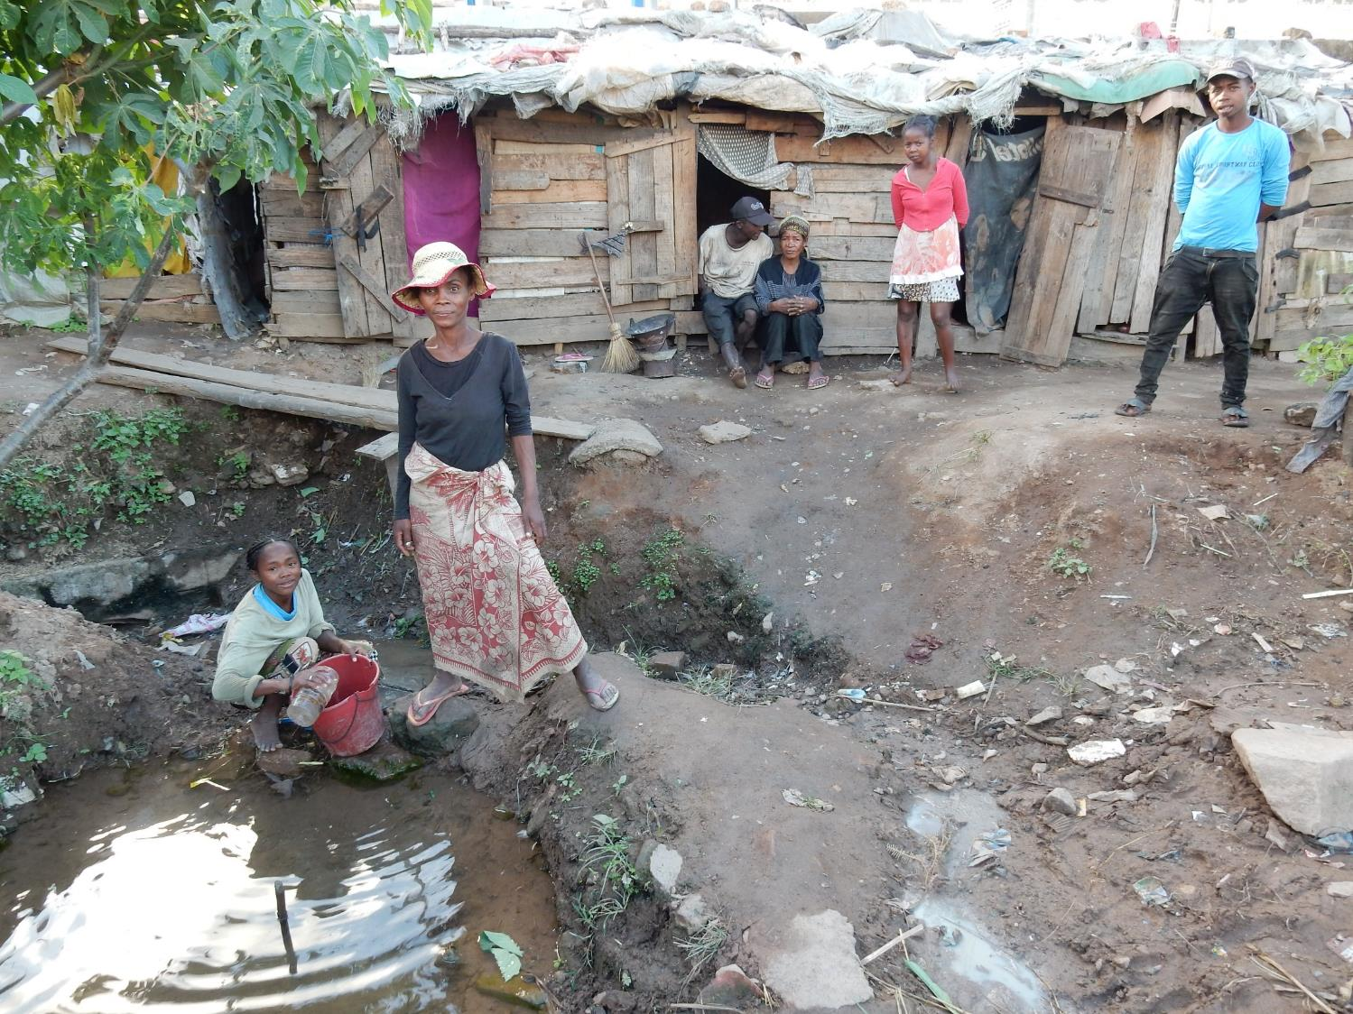



“MIVOATSE” Project:
“Multi-Initiatives for the Vulnerable of Ampasambazaha Towards Sustainable Employment”:
PROGRESS SINCE LAST PROGRESS REPORT IN MAY 2017

Slide 2
Adult educative sessions @ Lapan’ny Ankizy
Twice weekly sessions until the end of June, then 21 weekly sessions since July covering subjects such as management (money, project, daily rations), communication (inter-personal, negotiation), nutrition (mother & child, family). On average 18 participants / session. Always some new participants joining.
Results: reported reduction in marital conflicts /drinking, some improvements in communication & presentation. But greatest change since beneficiaries received project support – more self-confidence and pride.

Slide 3
Educative sessions @ Antsahasoa
Support to conflict resolution, awareness-raising about community solidarity
  7 agricultural sessions held (compost, cassava and sweet potato technique) with about 10 participants.
Results: Partial adoption of new techniques (e.g. 100 cassava plants planted in holes with compost)

Slide 4
2016 Beneficiaries’ Livelihoods Projects
Sadly very minimal long-term impact. Only 1 beneficiary household (David & Aline) still doing farming & still living in Antsahasoa.

Slide 5
2016 beneficiaries
No. | Name | Project | Situation
1 | VOAHANGY Lalao | Charcoal-selling | Died. Her daughter’s education in Ambatofinandrahana is supported.
2 | HECTOR Etienne & ZAVASOA | Agriculture & setting up a small grocery store | After a dispute with the neighbourhood in Antsahasoa, they have returned to Manakara.
3 | Laurent & Clara | Wooden cart “Varamba” & vegetable-selling | The varamba is still there but project failed. Live in Ambalavato.
4 | RAMERINA & Georgette | Cobbler & Fruit-selling | Sold bike & stand, Returned to live on the street in Ampasambazaha
5 | RANJALININA Voahangy [& Martin (Dadah)] | Raphia craft fabrication | They returned to Fianarantsoa from Antananarivo, & to the street in Ampasambazaha.
6 | RANDRIANANDRASANA Tina Fagot | Driving lessons /Mechanical training (project never launched) | Died of tuberculosis before project was launched
7 | RAMAMONJISOA Jean Louis Marie D & Harilalao | Selling household tools, & farming | The only ones remaining in Antsahasoa, but sales project has failed – they just continue to farm.
8 | RAMAHARIMAFY Zafihova L. Tsara & R. Larissa Marie | Selling bread and patisserie, & household tools | Now rent a room to live in Tanambao
9 | R. Natacha | Selling second-hand clothes | Project failed. Lives with Larissa in Tanambao
10 | R. Clarisse | Agriculture & animal husbandry (project never launched) | Left town to work in a mining site.
11 | Faramalala Sylvia | Selling second-hand clothes | Project failed when she left for Tana.
12 | NIVOARIMALALA & R. Pierre Robin | Selling hot soup. | Project failed when husband was imprisoned. Now washes clothes/ looks for odd jobs

Slide 6
2017 Beneficiaries’ Livelihoods Projects
20 projects launched:
  3 dress-making (2 underway)
  7 sales (1 failure)
  8 animal husbandry (problematic results)
  2 driving license (both obtained)
Constraints include one beneficiaries’ child being burnt and then hospitalised, resulting in her selling her chickens.
Another beneficiary (1 of the 5 successful in sales) was imprisoned for witchcraft!

Slide 7
Training on poultry-rearing & chicken distribution

Slide 8
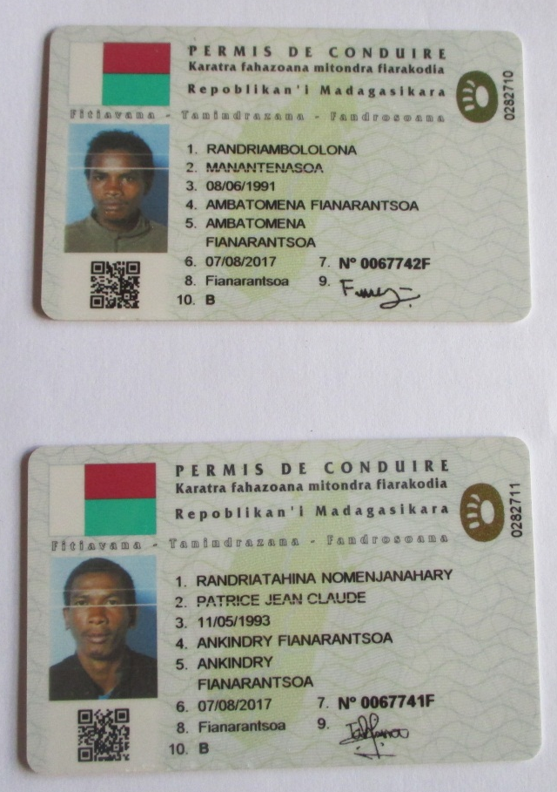
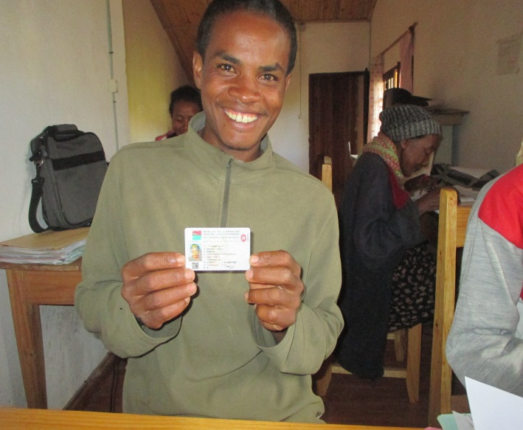
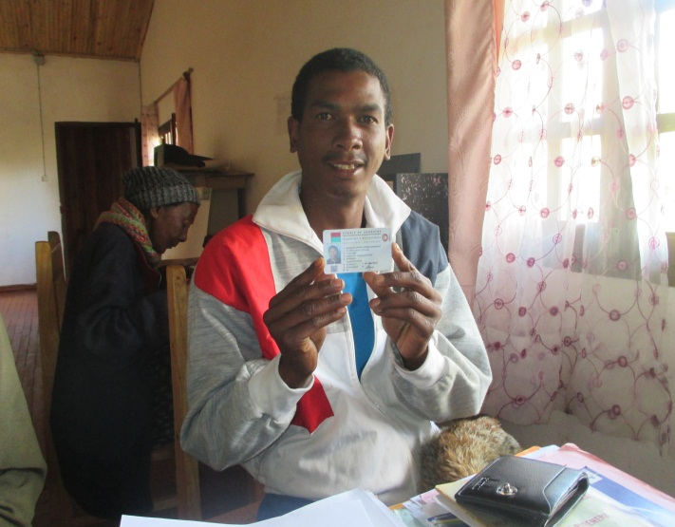
Tahiana et Manantenasoa with their driving licenses

Slide 9
Opening of Savings Accounts for Beneficiaries
18 beneficiaries have accounts
5 beneficiaries make regular payments into their accounts (all of these women & all from sales projects). Some others (including the seamstresses) plan to do so. Others keep savings at home.
Results noticed: Motivational factor to achieve objectives in their individual contracts. However, Juliette and Fanja are the only beneficiaries on track.

Slide 10
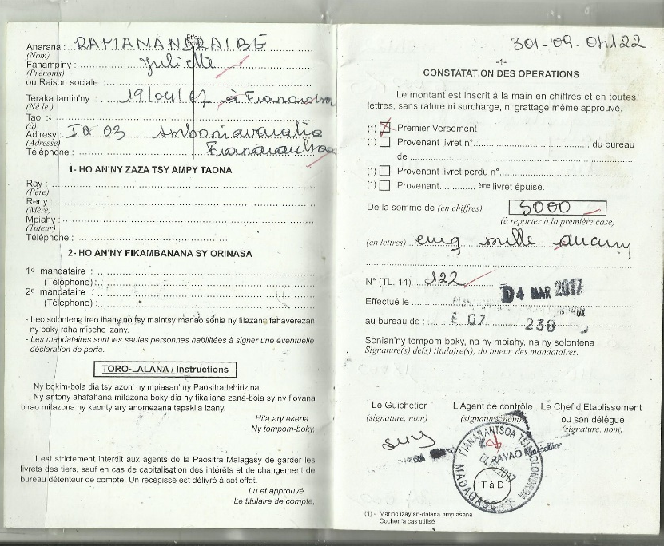

Slide 11
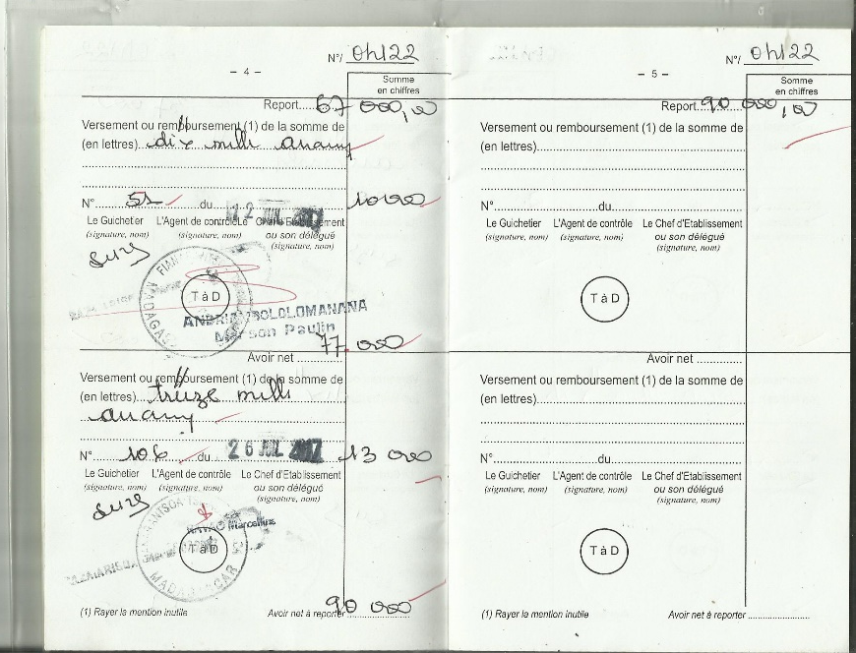

Slide 12
Extracurricular activities @ Lapan’ny Ankizy
Afternoon sessions held twice weekly until the end of June.
Around 28 participants at Friday sessions, less on Tuesdays.
Activities included basic learning of numbers, shapes, colours, reading, hygiene (hand-washing, etc.), sports, games and singing. Children were taken on an outing to Fianarantsoa’s Economic Fair in May.
Impact noticed: cleaner clothes, improved communication & manners, keenness to study and play. And most importantly, keeping the children off the street.

Slide 13
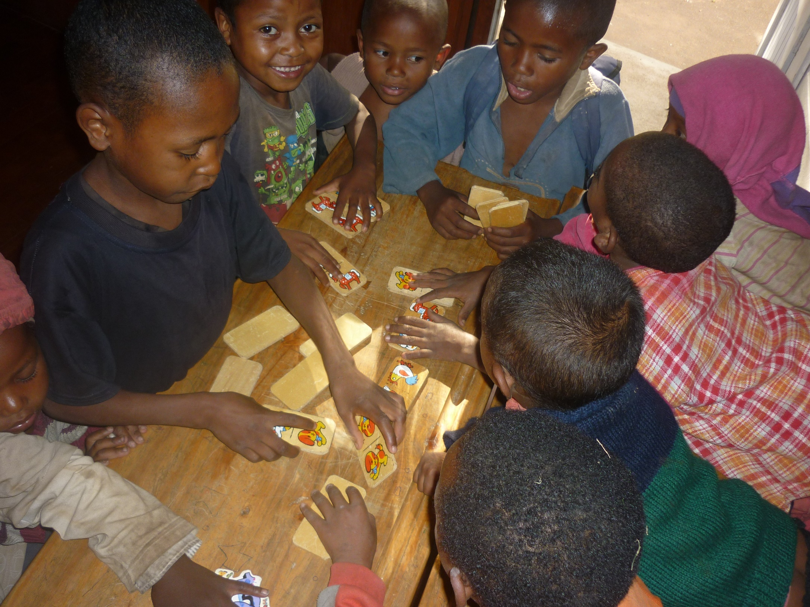

Slide 14
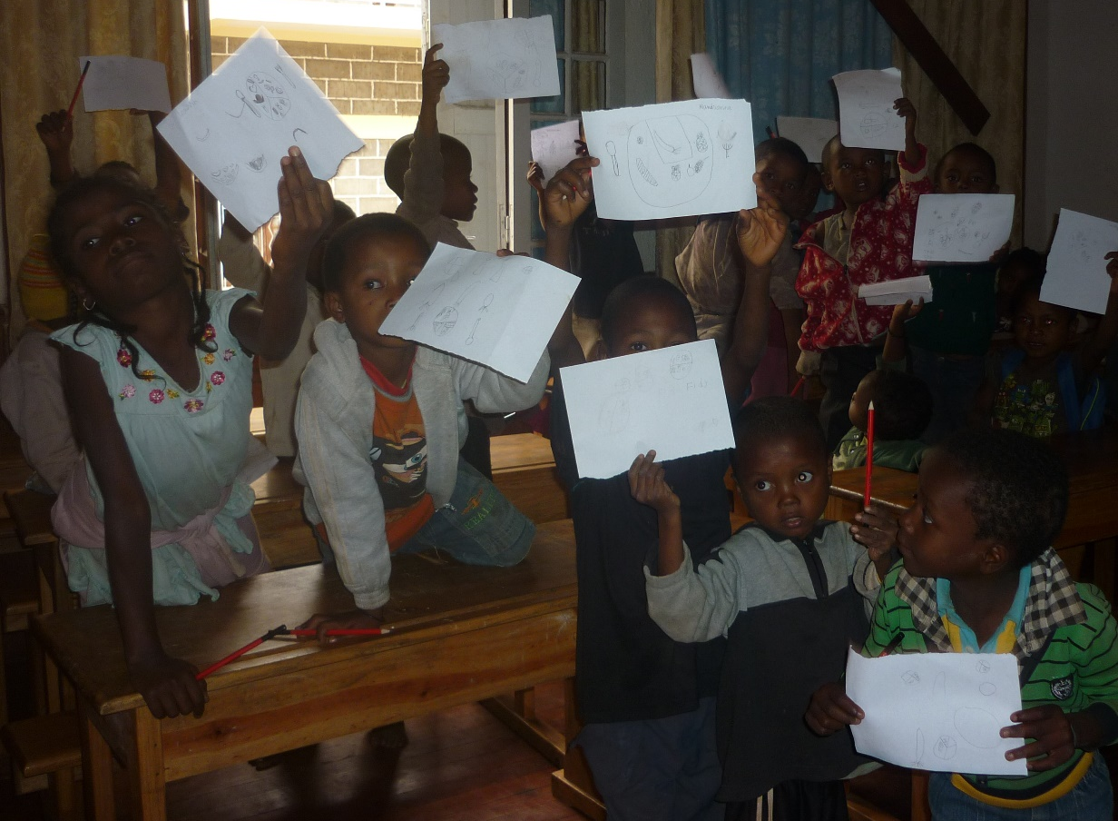
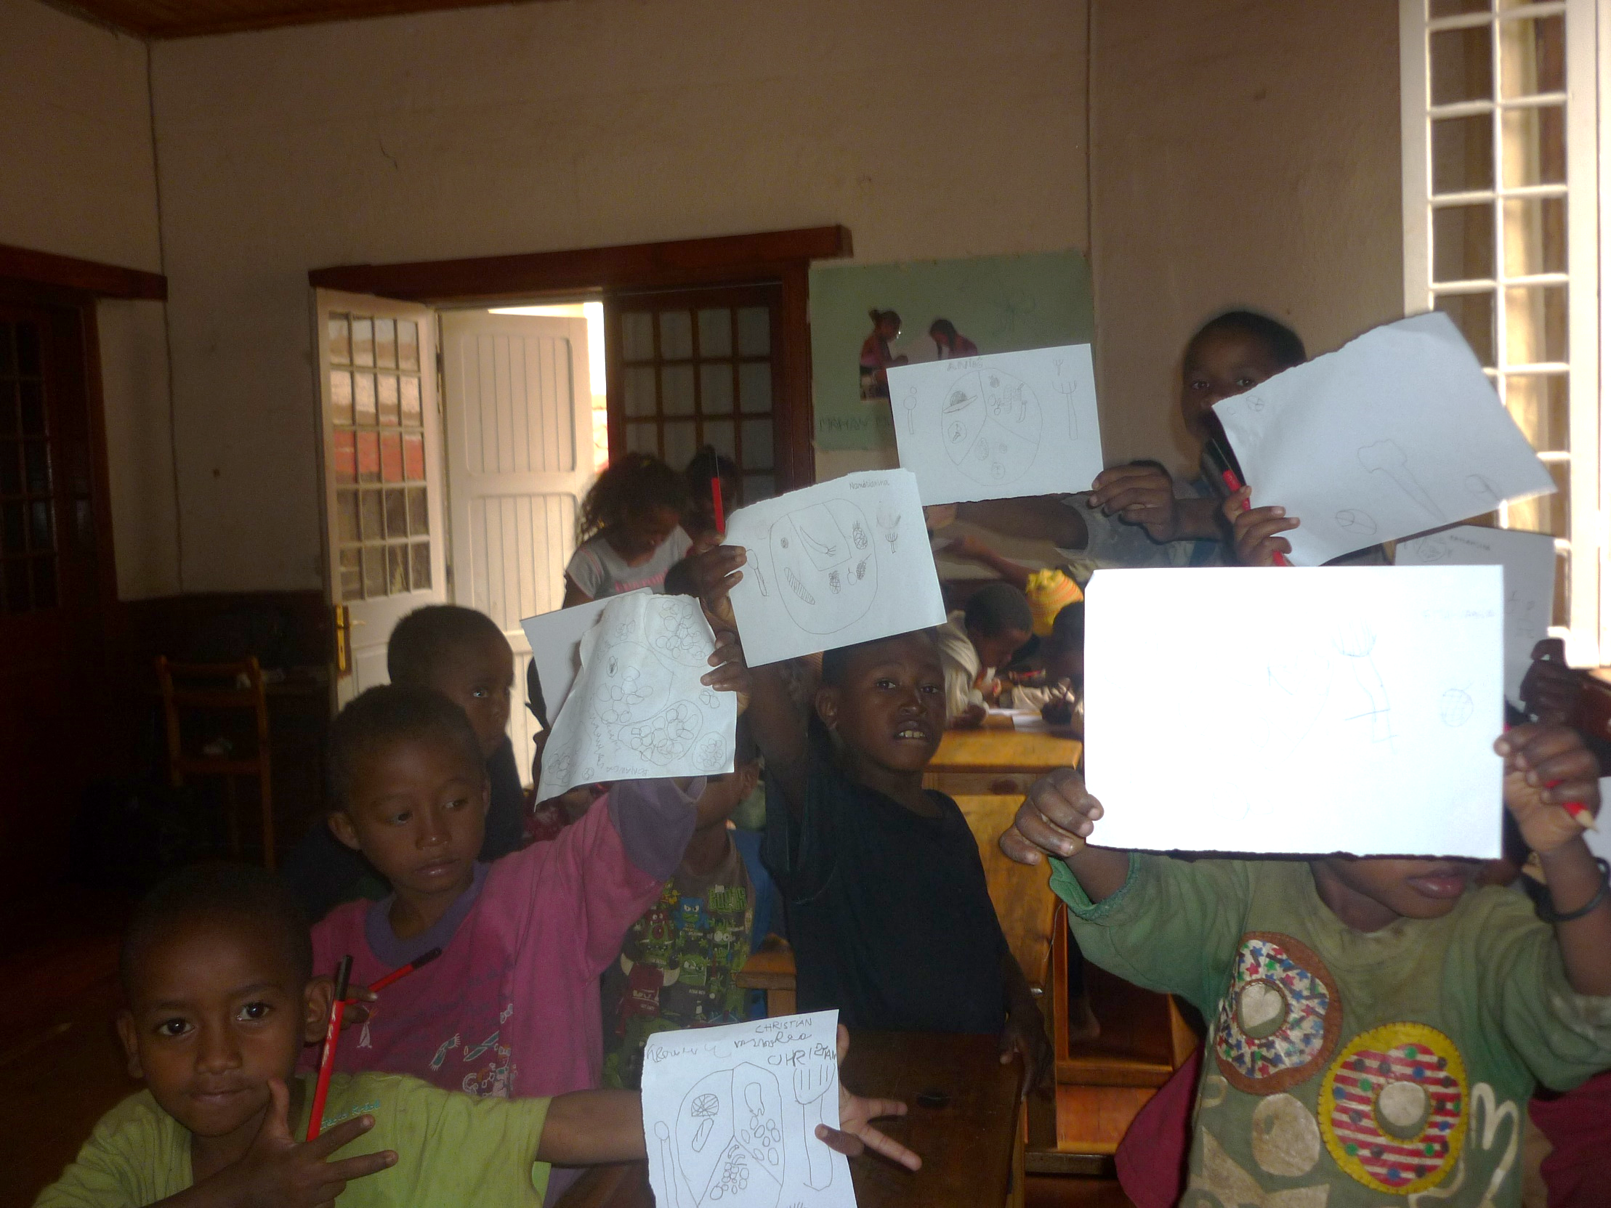

Slide 16
Schooling of unschooled children
Schooling carried out at Tsianolondroa Primary School until 28th July with Mme Suzanne as teacher: 37 pupils.
Impact: Improved behaviour & relations with other children (not fighting), parents keen to educate their children.
Collaboration with district education authorities, primary /secondary school head-teachers & nuns for the re-integration of these children back into normal schools:
  Rakotomalala Secondary School: 5
  Rakotozafy Alphonse Secondary School: 1
  Tsianolondroa Secondary School: 2
  Ankazobe Primary School: 5
  Tsianolondroa Primary School: 3
  Antarandolo Primary School: 4
  Antsororokavo Primary School: 14
  Centre I Primary School: 1
Just 2 pupils not enrolled for next school year

Slide 17
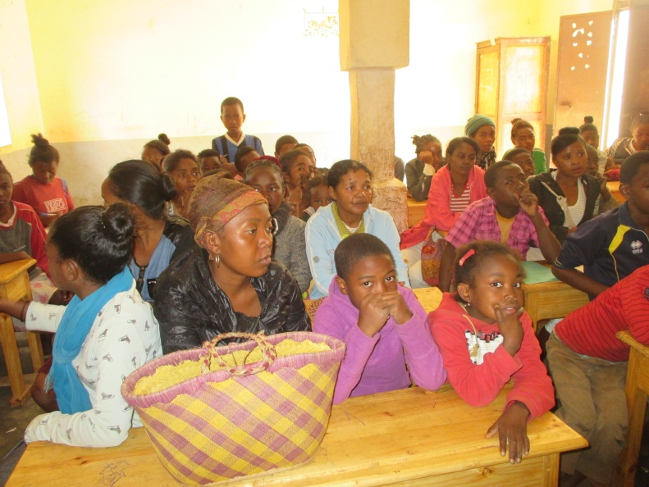
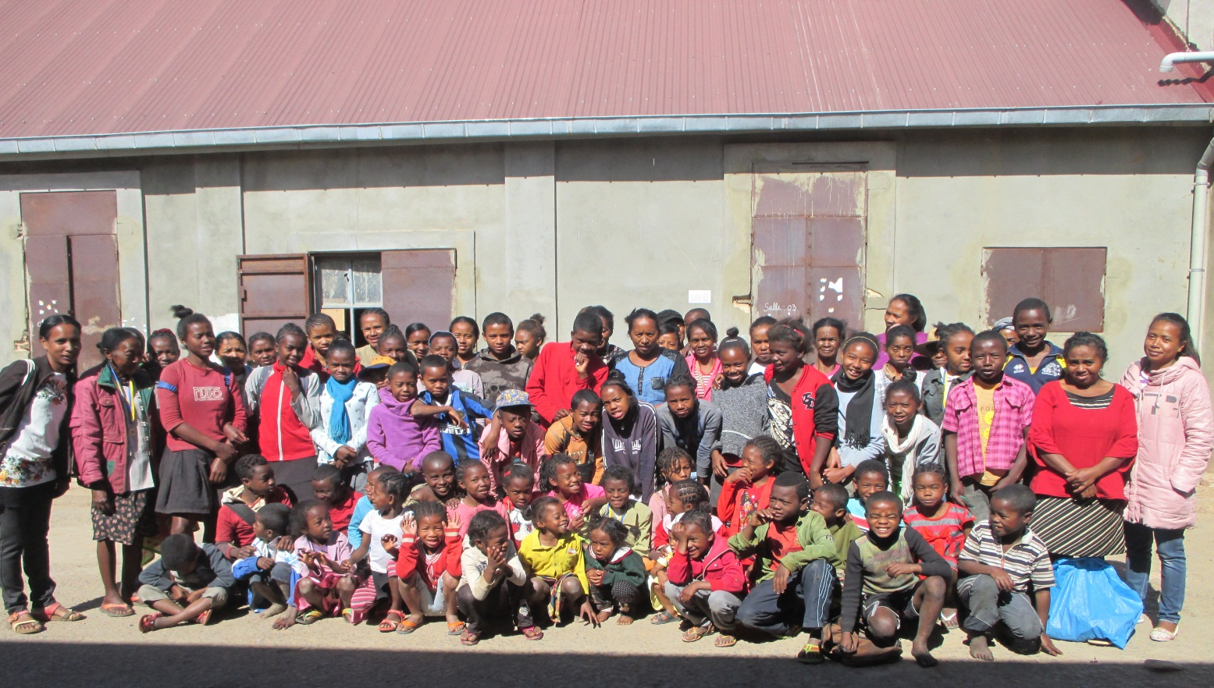
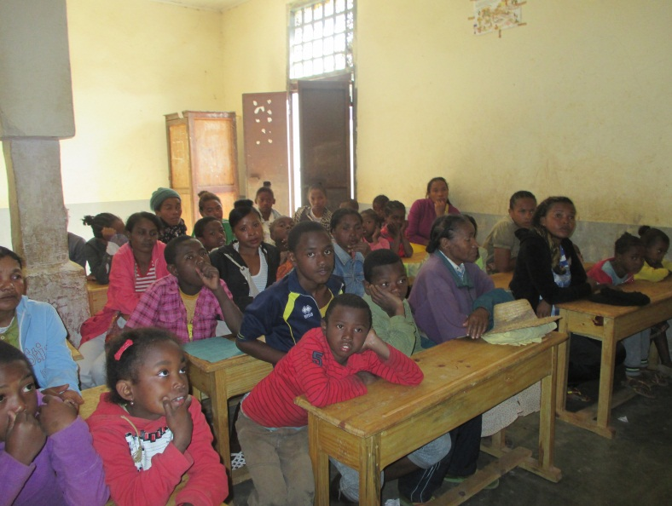
Meeting with parents of pupils at Tsianolondroa

Slide 18
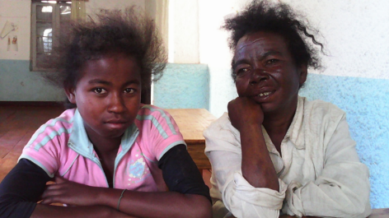
Success story of Valerie, Voanjy Lalao’s daughter who is schooled with the nuns in Ambatofinandrahana, & who has avoided returning to the street during the school holidays.

Slide 19
Infrastructure improvements
Antsahasoa residents now with a supply of water for washing purposes.
New residents due to move-in after current rehabilitation is complete.
Borehole feasibility study realised for Antsahasoa.

Slide 20
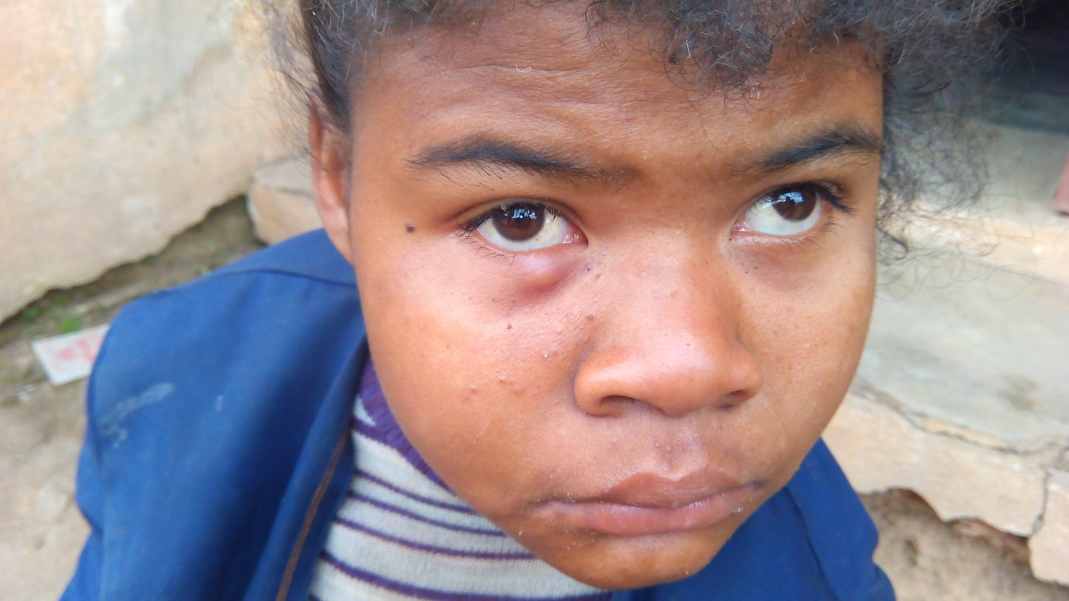
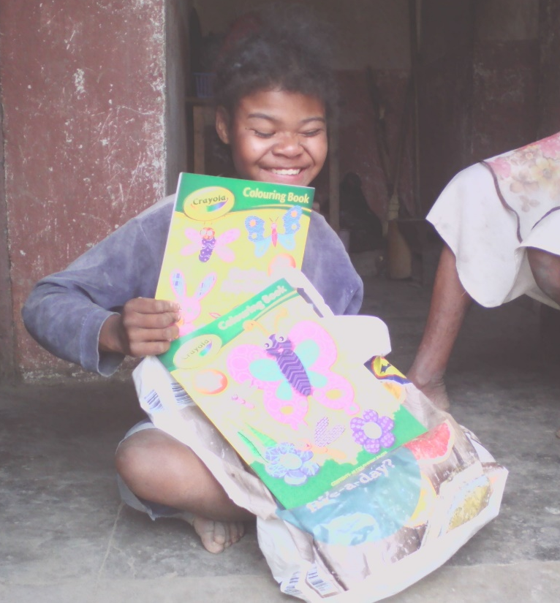
Noro
Had conjunctivitis twice (June & August): help with treatment.
Currently in Vohipeno for 3 months or until new year.
Supplementary food /pocket-money funds sent to Auguste monthly for weekly payments (21,000 Ar/week).

Slide 21
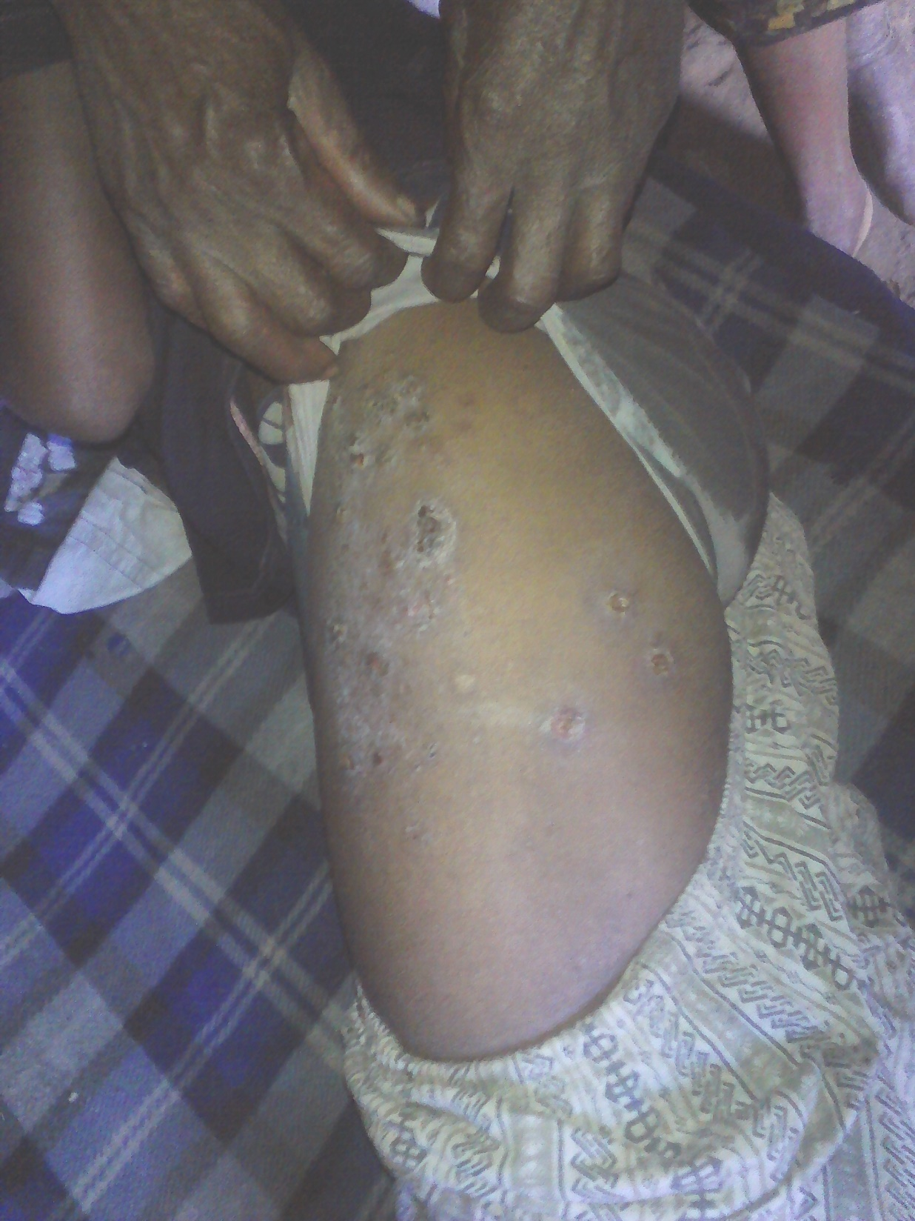
Various
Treatment of health problems (Mme Suzanne’s flu, a pupil’s sore, …)
Child rape case: was settled out-of-court between the families, with 4.5 million Ariary agreed as pay-out. However, to date just 500,000 Ariary has been paid. We are encouraging the mother to insist on payment.

Slide 22
Various
Fianarantsoa googlegroup set up for those working to support the homeless, but yet to be functional
Positive impact of birth certificate/ National identity card campaign: increased enrolment of pupils, possibility to sit exams & to obtain national identity card, greater freedom to leave employers who exploit.
In general, increase in homelessness in Fianarantsoa with bus-stops all occupied at night: insanitary, increase in child begging (particularly during school holidays) as parents force them. No municipality policy/programme to deal with it.

Slide 23
Infrastructure improvements underway
Rehabilitation of Antsahasoa complex, and additional house bordering the RN7
Noro’s house (change of location to near the school)
Extension of school for the handicapped (large room for events & canteen)

Slide 24
Itinerary Sunday 24 Sept 2017
2pm | Presentation of progress @ Cotsyo
3pm | Visit beneficiaries @ Complexe
4pm | Visit de beneficiary Juliette @ Ambozontany
4.30pm | Visit de beneficiary Celine @ Beravina
5pm | VisiVisit de beneficiary Rosette @ Ankofafa Ambany
5.30pm | Return to Cotsyo

Slide 25
Itinerary Monday 25 Sept 2017
9am | Official hand-over of furniture at the Tsianolondroa Primary School, speechs & distribution of snack to students present. Media
10am | Leave for Andaobato
10.30am | Foundations ceremony @ School for Handicapped in Andaobato, & Noro’s house
 | Visit of renovation work underway on other half-way house along RN7
11am | Cocktail and distribution of snacks to pupils
11.30am | Visit of renovation works in Antsahasoa
Afternoon | Debriefing & discussion of perspectives for 2018

